Slide 1
Operating Lease
A short brief of
Neny W.
(2nd Oct 2019)

Slide 2
What is Operating Lease?
Operating lease is a type of lease in which the lessor purchases the asset and leases it to the lessee for a limited and small period of time.
It is generally treated like renting. The lease payments are treated as operating expenses and the asset does not show on the balance sheet.
The ownership of the asset remains with the lessor for the entire lease period.
The lessor would need to take care and maintain the asset

Slide 3
Finance Lease vs Operating Lease
DIFFERENCE | FINANCE LEASE | OPERATING LEASE
MEANING | A commercial contract in which the lessor lets the lessee to use an asset in lieu of periodical payments for usually long period. | A commercial contract where the lessor allows the lessee to use an asset in lieu of periodical payments for a small period of time.
WHAT IS ALL ABOUT | Financial lease is a long term concept. | Financial lease is a short term concept.
TRANSFERABILITY | The ownership is transferred to the lessee. | The ownership remains with the lessor.
TERM OF LEASE | It is a contract for long term. | It is a contract for short term.
NATURE OF CONTRACT | The contract is called loan agreement/contract. | The contract is called rental agreement/contract.

Slide 4
Finance Lease vs Operating Lease
DIFFERENCE | FINANCE LEASE | OPERATING LEASE
MAINTENANCE | Lessee would need to take care and maintain the asset. | Lessor would need to take care and maintain the asset.
RISK OF OBSOLESCENCE | It lies on the part of the lessee. | It lies on the part of the lessor.
CANCELLATION | It lies on the part of the lessee. | It lies on the part of the lessor.
TAX EXPENSES | The expenses for the asset such as depreciation, financing are allowed for tax deduction to lessee. | Even the lease rent is allowed to be deducted from the tax.
PURCHASING OPTION | In financial lease, the lessee is given an option to purchase the asset he has taken on lease. | In operating lease, the lessee is not given any such option.

Slide 5

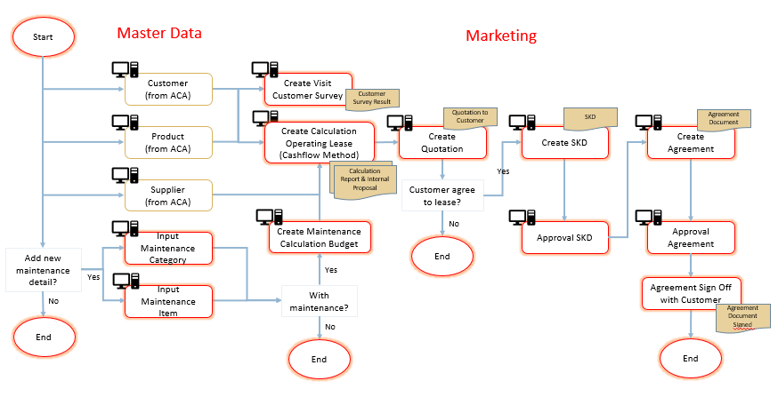
Business Process (1)

Slide 6
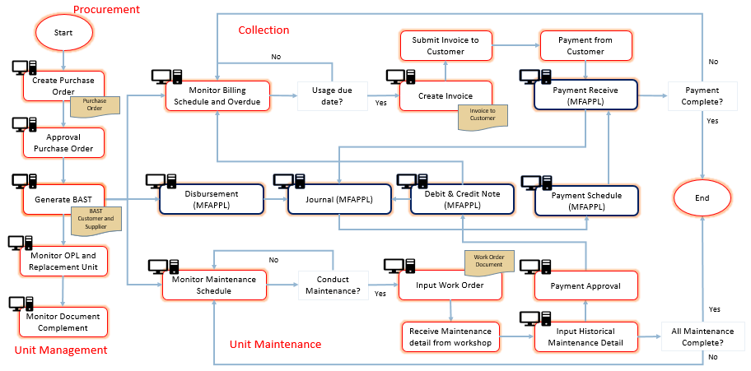
Business Process (2)

Slide 7
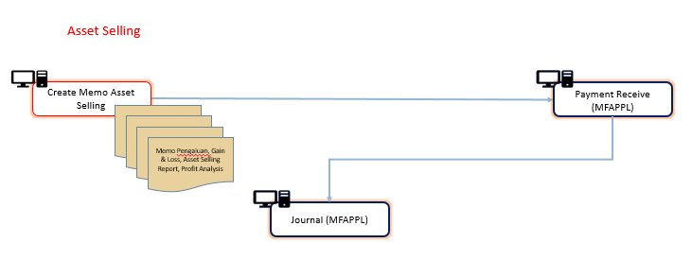
Business Process (3)

